Slide 1

KKBOX 如何使用 mrjob 連結
Python, hadoop, aws
Aaronlin

Slide 2

About KKBOX

Slide 3

About KKBOX

Slide 4


Slide 5


為音樂愛好者創造最全面性的音樂體驗
透過網路與技術的創新，提供歌手藝人與他們的音樂更多宣傳平台、管道

Slide 6


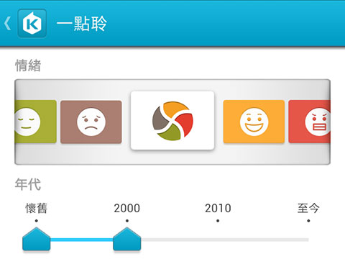
About me
Aaron Lin
aaronlin@kkbox.com
研究中心頭子
KKBOX 研究中心過去成果

Slide 7
科科科技目前所面對到的科科難題是…?

Slide 8



MORE THAN
10,000,000
USERS

Slide 9

MORE THAN
10 MILLION SONGS

Slide 10
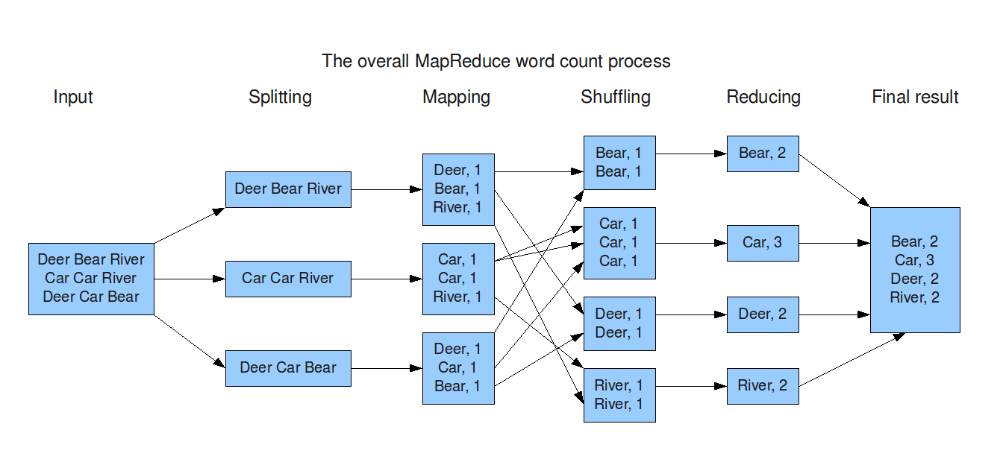
兩團巨量資料交會之下
Need to use map-reduce to perform experiments
map-reduce: map → sort → reduce

Slide 11
為什麼要使用 mrjob?
What is mrjob
Open source project founded by Yelp
https://github.com/Yelp/mrjob
Docs: https://pythonhosted.org/mrjob/
A python library for writing map-reduce job
Can cooperate with hadoop cluster and AWS very easily
Why python?
Because of we love python
Why AWS Elastic MapReduce (EMR)?
if hadoop cluster has no resources left, use EMR
If hadoop cluster cannot finish the job in time, use EMR
mrjob can audit your expense and effectiveness of each job

Slide 12
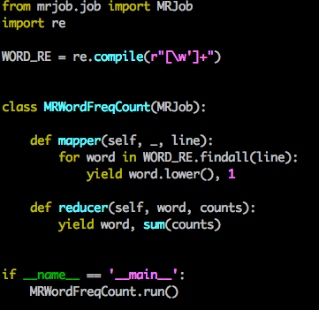
First mrjob program
Three steps
Define your question into map-reduce
Write your mapper
Write your reducer
That’s it!
mrjob can run in three ways
Locally
Hadoop
AWS EMR

Slide 13
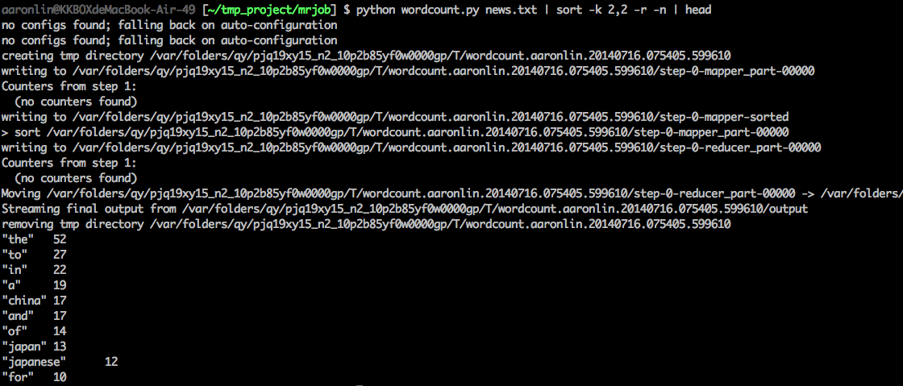
Run mrjob locally
Either way works
python wordcount news.txt
cat news.txt | python wordcount.py
cat news.txt | python wordcount.py --mapper | sort | python wordcount.py --reducer

Slide 14
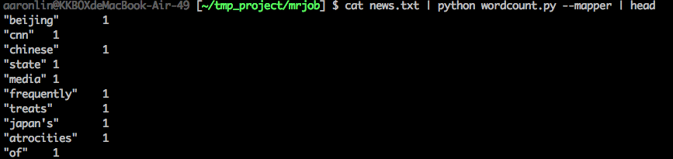
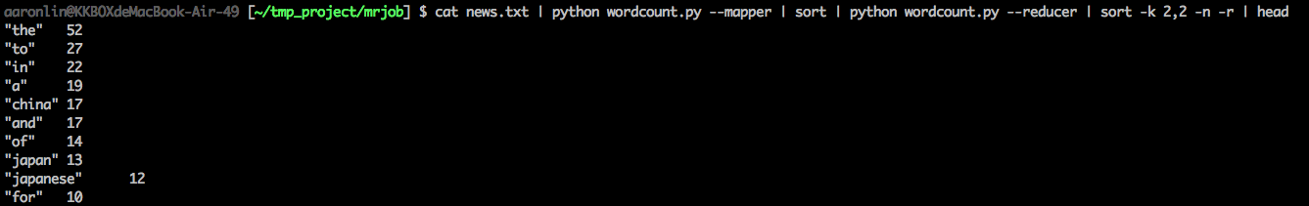
Run mrjob locally
Easy to test since mapper/reducer can be run individually

Slide 15
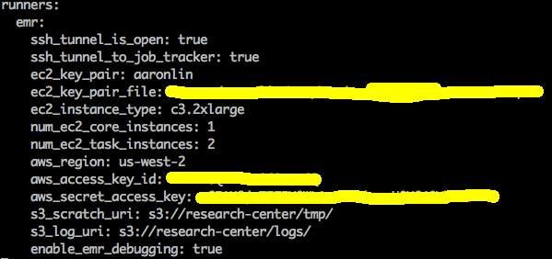
Run mrjob in EMR
Write .mrjob.conf in HOME folder

Slide 16
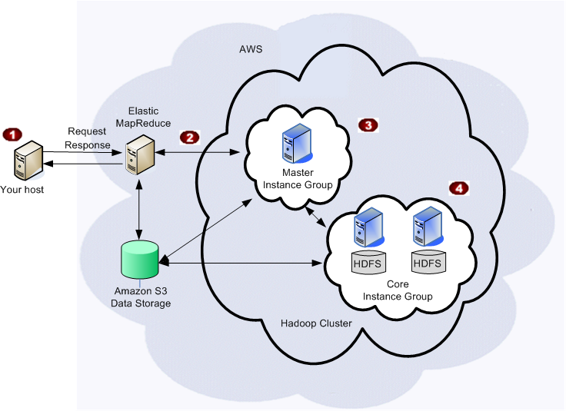
Instance type of each group
m1.small
task
c3.2xlarge
c3.2xlarge

Slide 17
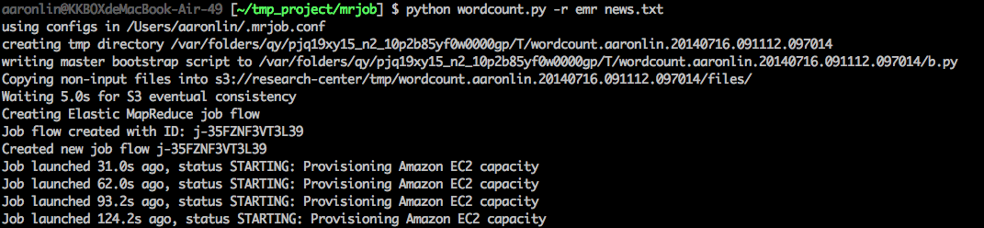
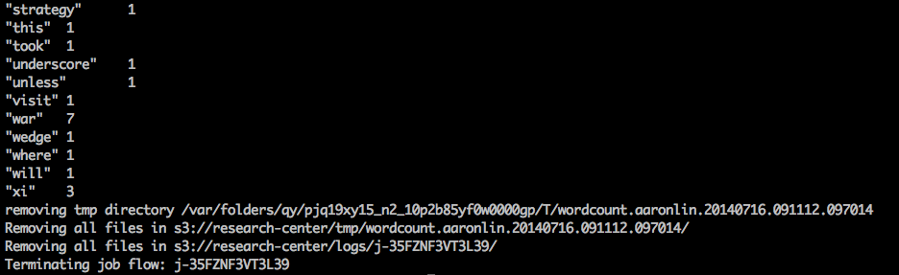
Run mrjob in EMR
Use -r to specify the runner
python wordcount.py -r emr news.txt
python wordcount.py -r emr s3://xxxx/news.txt

Slide 18
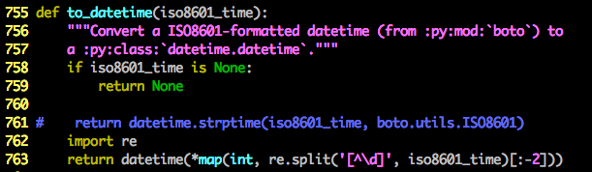
Run mrjob in EMR
How to audit emr usage
mrjob audit-emr-usage
If you have ValueError since datetime format does not match
Fix it in <mrjob folder>/audit_usage.py

Slide 19
來點難一點的問題

Slide 20


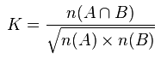
Let’s try to find related artists
A-Mei vs Hebe

Slide 21
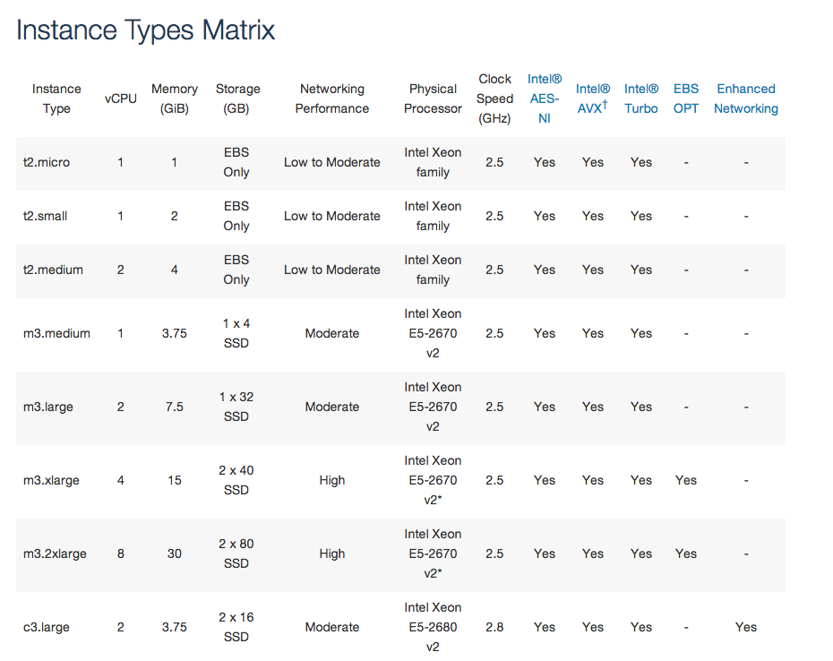
Let’s try to find related artists
Write a cool program to compute it
But we don’t know which AWS instance type is the best

Slide 22


Slide 23
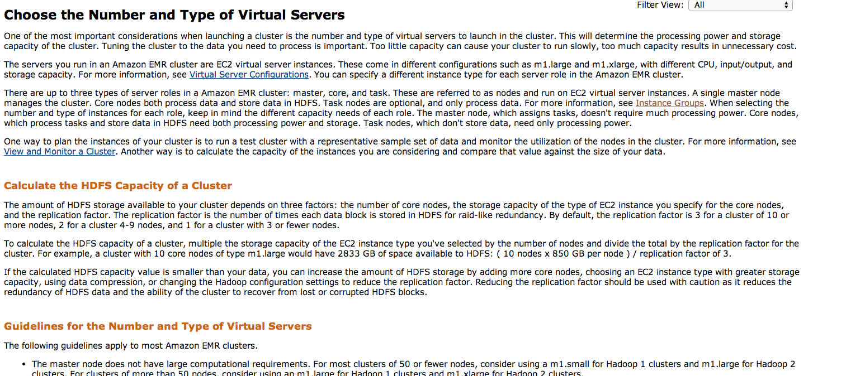
If you check the official document
http://docs.aws.amazon.com/ElasticMapReduce/latest/DeveloperGuide/emr-plan-instances.html

Slide 24


Slide 25
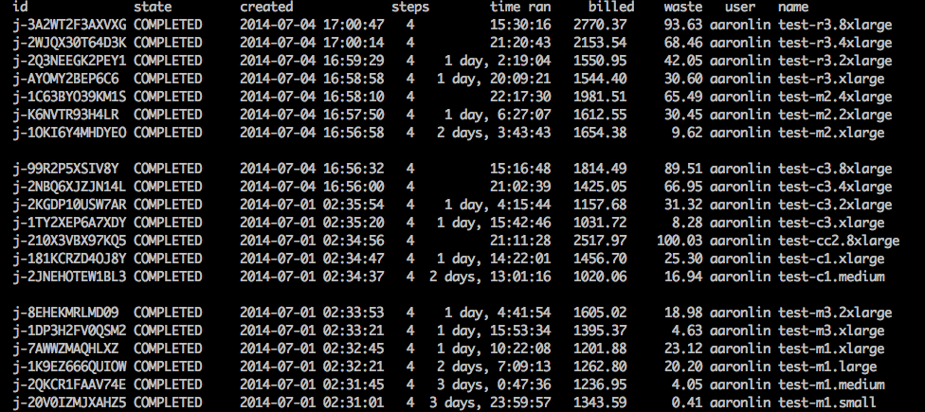
I like brute force…
Memory optimized instance
Compute optimized instance
General purpose instance

Slide 26
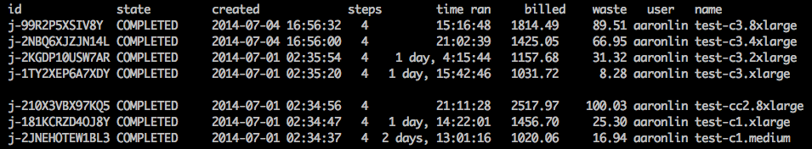
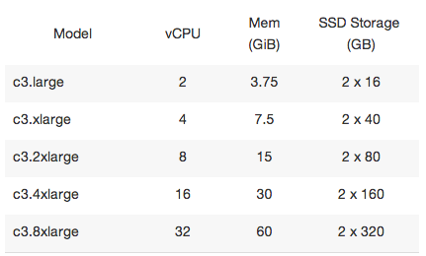
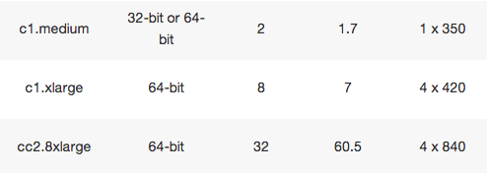
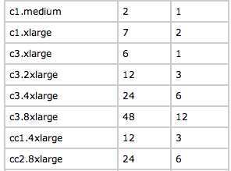
Focus on compute optimized instance
Current generation instance is better

Slide 27
Focus on compute optimized instance
Current generation instance is better

Slide 28
Focus on compute optimized instance
Current generation instance is better

Slide 29

c3.2xlarge seems great, but…
Evaluation is specific to this task
Brute force search is too lazy……
Cost about 1500 NTD per run……
Hadoop/AWS is a buzz word
The money you spend is real
Buying some low-cost computers to run is always an option

Slide 30
Reference
mrjob
https://github.com/Yelp/mrjob
Docs: https://pythonhosted.org/mrjob/
Hardware spec of each instance type
http://aws.amazon.com/ec2/instance-types/
Number of mapper/reducer of each instance type
http://docs.aws.amazon.com/ElasticMapReduce/latest/DeveloperGuide/TaskConfiguration_H1.0.3.html

Slide 31


z
We are hiring!
http://www.kkbox.com/jobs/

